Slide 1
EXTREME Q-LEARNING: MAXENT RL WITHOUT ENTROPY
PRESENTER: YU-CHENG CHEN
ID: 311551059
Notes:
大家好，我是yucheng chen。我要present的paper是Extreme Q Learning: Maxent RL without Entropy.
Hello everyone, I am Yucheng Chen. The paper I will be presenting is "Extreme Q Learning: Maxent RL without Entropy".

Slide 2
Reference
Title:
Extreme Q-Learning: MaxEnt RL without Entropy
Conference:
ICLR 2023
Author:
Divyansh Garg, Joey Hejna, Stefano Ermon (Stanford University)
Matthieu Geist (Google Brain)
Notes:
這是一篇今年發表在ICLR 2023的paper，由來自stanford和google brain的作者合出的。
This is a paper published at ICLR 2023 this year by authors from Stanford and Google Brain.

Slide 3
Outline
Introduction
Preliminaries
Extreme Q-Learning
Experiments
Conclusion
Notes:
今天的outline包含introduction, preliminaries, 本篇主要算法Extreme Q learning, experiments和conclusion。
Today's outline includes an introduction, preliminaries, the main algorithm of this paper, Extreme Q learning, experiments, and conclusion.

Slide 4
Introduction

Slide 5
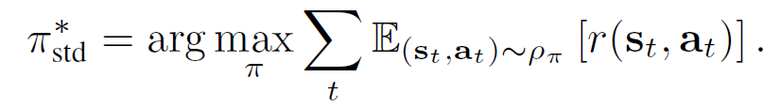
Introduction
Standard MDP:
Regularized MDP:
Notes:
在普通的mdp設定下，我們的目標是maximize total expected return。而在regularized mdp底下，我們的objective function必須加上一個entropy term，這裡寫作H。
In a standard MDP setting, our goal is to maximize the total expected return. However, in a regularized MDP, our objective function must include an entropy term, denoted as H here.

Slide 6
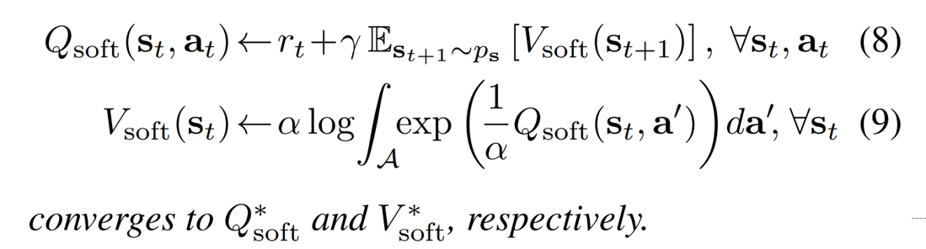
Introduction
Soft Q learning solves Regularized MDP:
Notes:
而在2017年發表的soft q learning證明了Q-soft和V-soft用這兩條式子迭代更新，會收斂到最佳解。
In 2017, Soft Q Learning was proposed, which proved that updating Q-soft and V-soft using these two equations iteratively would converge to the optimal solution.

Slide 7
Introduction
Soft Q learning solves Regularized MDP:
Problem: intractable in high-dimensional action spaces
Notes:
但是V這條更新式包含了對整個action space做積分，這在high dimensional action space，例如continuous action，是明顯不可行的。
However, the V update equation involves integration over the entire action space, which is clearly infeasible for high-dimensional action spaces such as continuous actions.

Slide 8
Introduction
Previous methods such as SQL and SAC had to bypass the high-dimensional action space problem using other methods.
This paper presents a novel loss objective that can deal with this problem.
Notes:
而之前的算法像是SQL和SAC都是用了其他方法或技巧繞過了這個問題。這篇paper present了一條新的loss objective可以解決這個問題。
Previous algorithms such as SQL and SAC have used alternative methods or tricks to overcome this problem. This paper presents a new loss objective that can solve this problem directly.

Slide 9
Introduction
The advantage of this novel loss objective:
Update soft value function without current policy.
Doesn’t need sampling, doesn’t encounter high-dimensional action space problem.
Doesn’t need calculating entropy from policy.
Easy to implement.
Can work in both online RL and offline RL.
Notes:
這個loss function有幾個優點:
他不需要current policy的參與，就可以update soft value function。這代表他不需要sampling action或迭代整個action space，也就不會遇到剛剛提到的那個問題。
他很容易實作
他可以work在online RL和offline RL這兩種setting中。
This loss function has several advantages:
It does not require the involvement of the current policy to update the soft value function. This means that it does not require sampling actions or iterating over the entire action space, thus avoiding the problem mentioned earlier.
It is easy to implement.
It can work in both online RL and offline RL settings.

Slide 10
Preliminaries

Slide 11


Preliminaries
A general version of Maximum Entropy RL,
Objective:
Online: uniform
Offline: behavior policy $π_{D}$ that generated the fixed dataset D
The KL-constraint, keep learned policy close to the behavior policy.
Notes:
首先，介紹一個Maximum entropy RL的general version。也就是下面這條式子。注意這邊除以一個mu。在online setting中，mu是一個uniform distribution；在offline setting中，mu是generate一個fixed dataset的behavior policy。
通常offline RL指的是不用policy與環境互動產生trajectories，而是用其他方式蒐集一個固定的buffer，可能是expert產生的trajectories。因此這個mu，實作上通常是未知的。
而後面這一項entropy term又可以被視為一個KL constraint，讓learned policy和behavior policy不要離得太遠。
First, let me introduce the general version of Maximum Entropy RL, which is represented by the following equation. Note that there is a division by mu. In the online setting, mu is a uniform distribution, while in the offline setting, mu is the behavior policy that generates a fixed dataset. Usually, offline RL refers to a setting where trajectories are not generated by interacting with the environment using a policy, but instead, a fixed buffer is collected in some other way, such as by expert demonstrations. Therefore, this mu is typically unknown in practice. The entropy term in the equation can be viewed as a KL constraint that ensures that the learned policy does not deviate too far from the behavior policy.

Slide 12


Preliminaries
Then the soft optimal V* satisfying:
While the optimal policy $π^{∗}$ satisfying:
Proof provided in Handout section 5.
We call this Log-Sum-Exp (LSE) term.
Notes:
接著，我們就可以解出soft optimal V function和soft optimal policy。解法和證明請參考handout的section 5。另外，V這條式子包含一個log、一個summation、一個exponential，因此我們稱這個V最佳解為一個Log-sum-exp term over Q。
We can then solve for the soft optimal V function and soft optimal policy. The solution and proof can be found in section 5 of the handout. Additionally, the V equation involves a log, a summation, and an exponential, so we refer to the optimal solution for V as a Log-sum-exp term over Q.

Slide 13
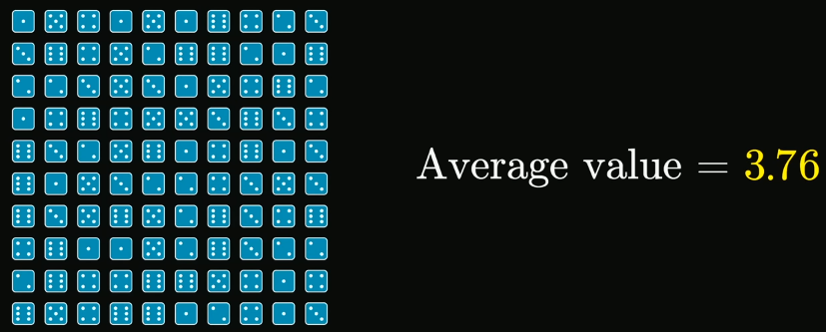
Preliminaries
Central Limit Theorem
For identically distributed independent samples (i.i.d.), the standardized sample mean tends towards the standard normal distribution regardless of the distribution of the original variables.
For example, rolling 100 dices n times, n is sufficiently large:
Notes:
我們先介紹Central limit therorem。他在說的是For identically distributed independent samples (i.i.d.), the standardized sample mean tends towards the standard normal distribution regardless of the distribution of the original variables.
舉例來說，擲100個骰子n次，n足夠大時。假設第一次100個骰子的平均是3.76、
First, let me introduce the Central Limit Theorem. It states that for identically distributed independent samples (i.i.d.), the standardized sample mean tends towards the standard normal distribution regardless of the distribution of the original variables.
For example, if we roll 100 dice n times, where n is sufficiently large, and let's say that the average of the first 100 dice rolls average is 3.76,

Slide 14
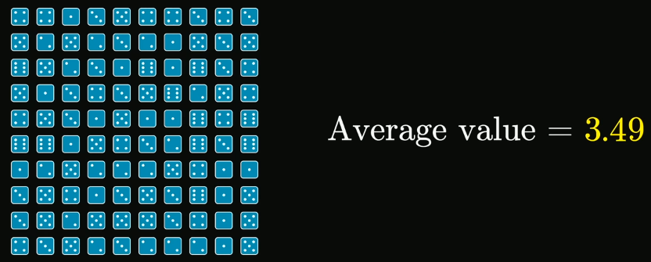
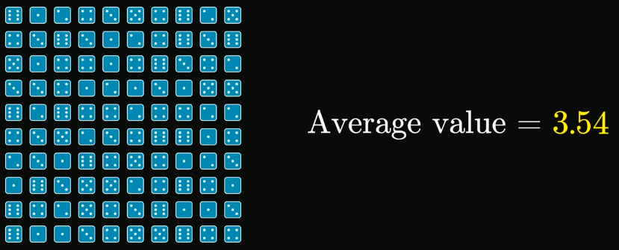
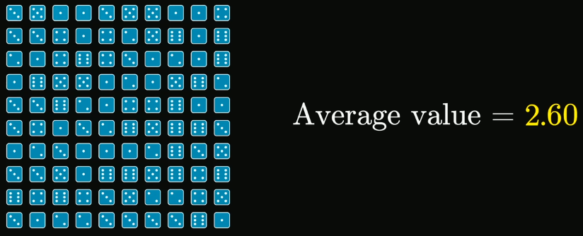
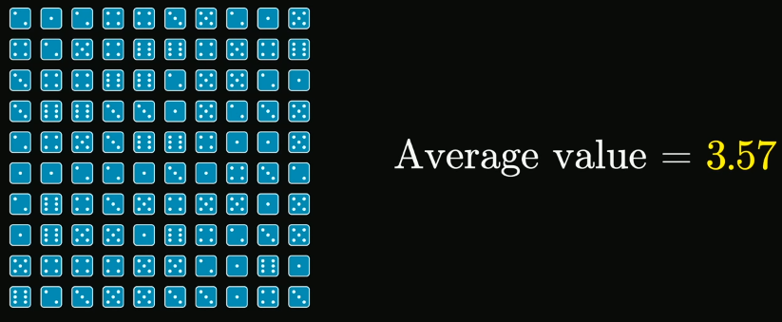
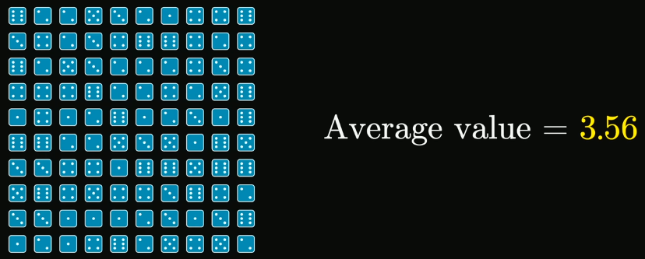
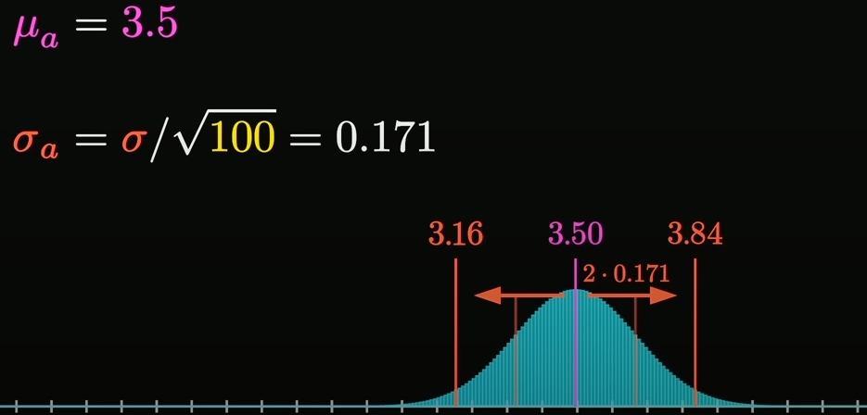
n times
Then the distribution of average:
Notes:
第二次是3.49、3.54……將這n次的結果統整起來，會呈現一個normal distribution。
the second is 3.49, the third is 3.54, and so on. When we aggregate the results of these n rolls, they will follow a normal distribution.

Slide 15
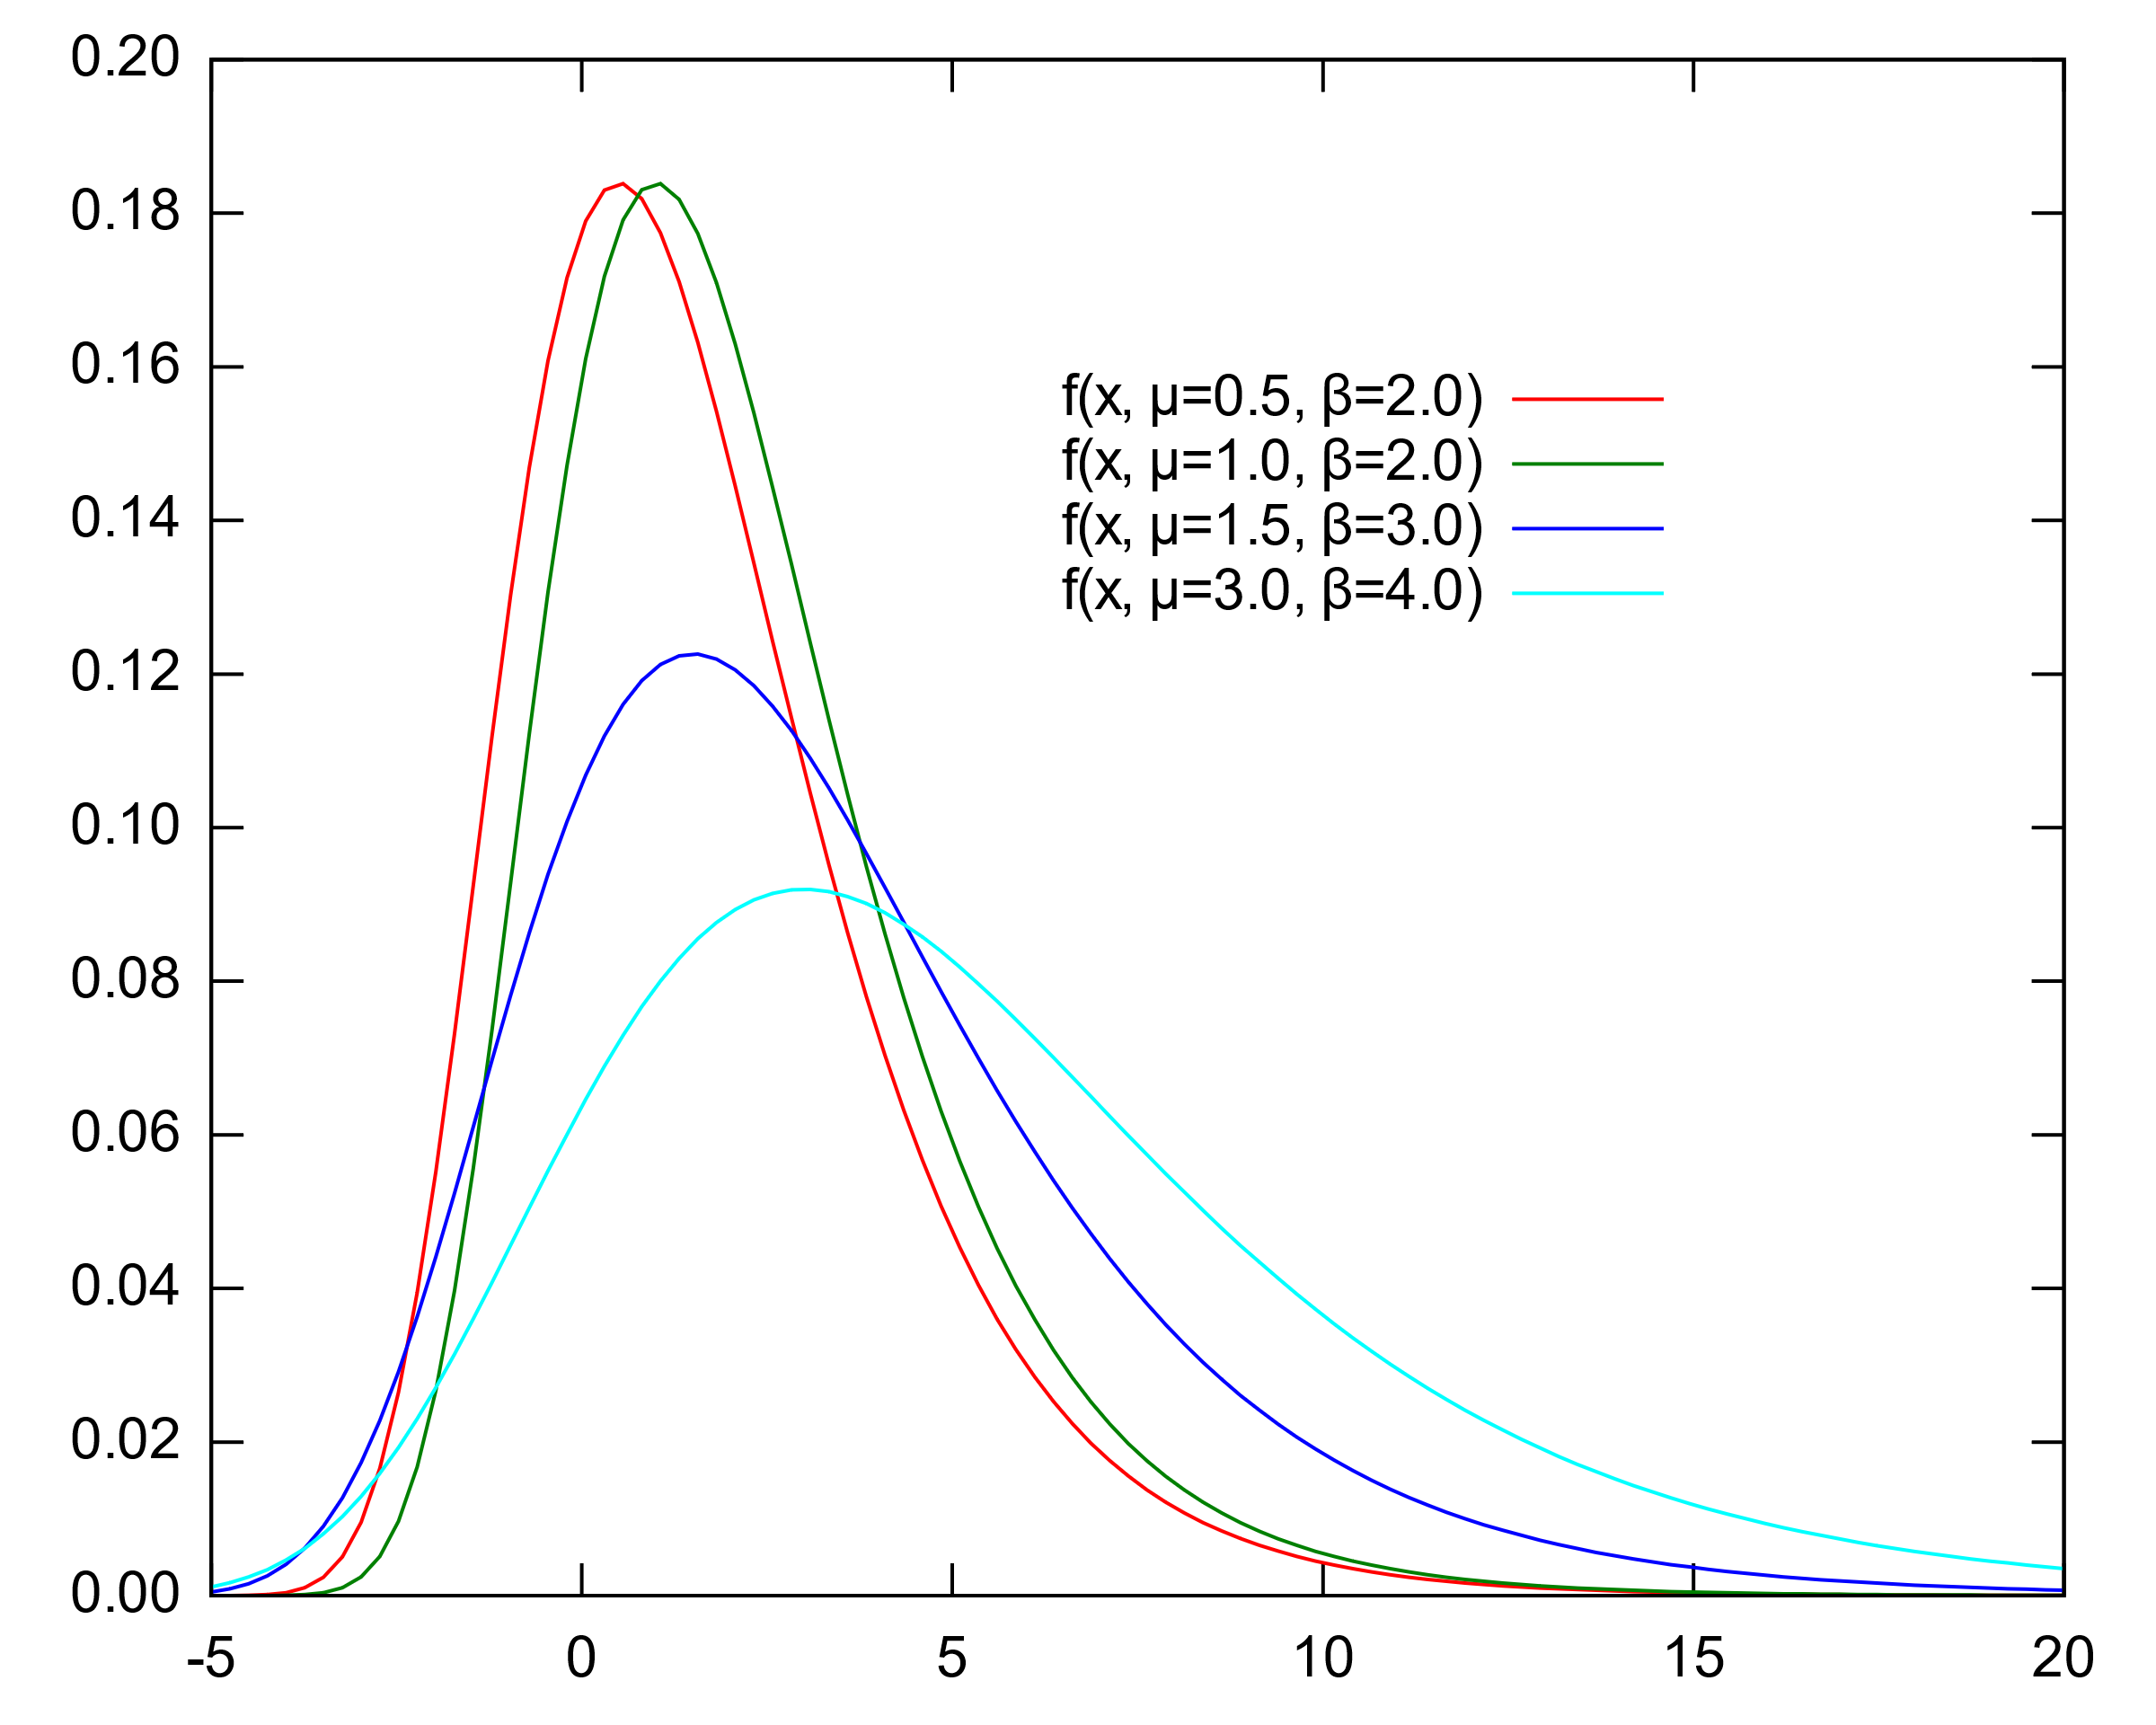
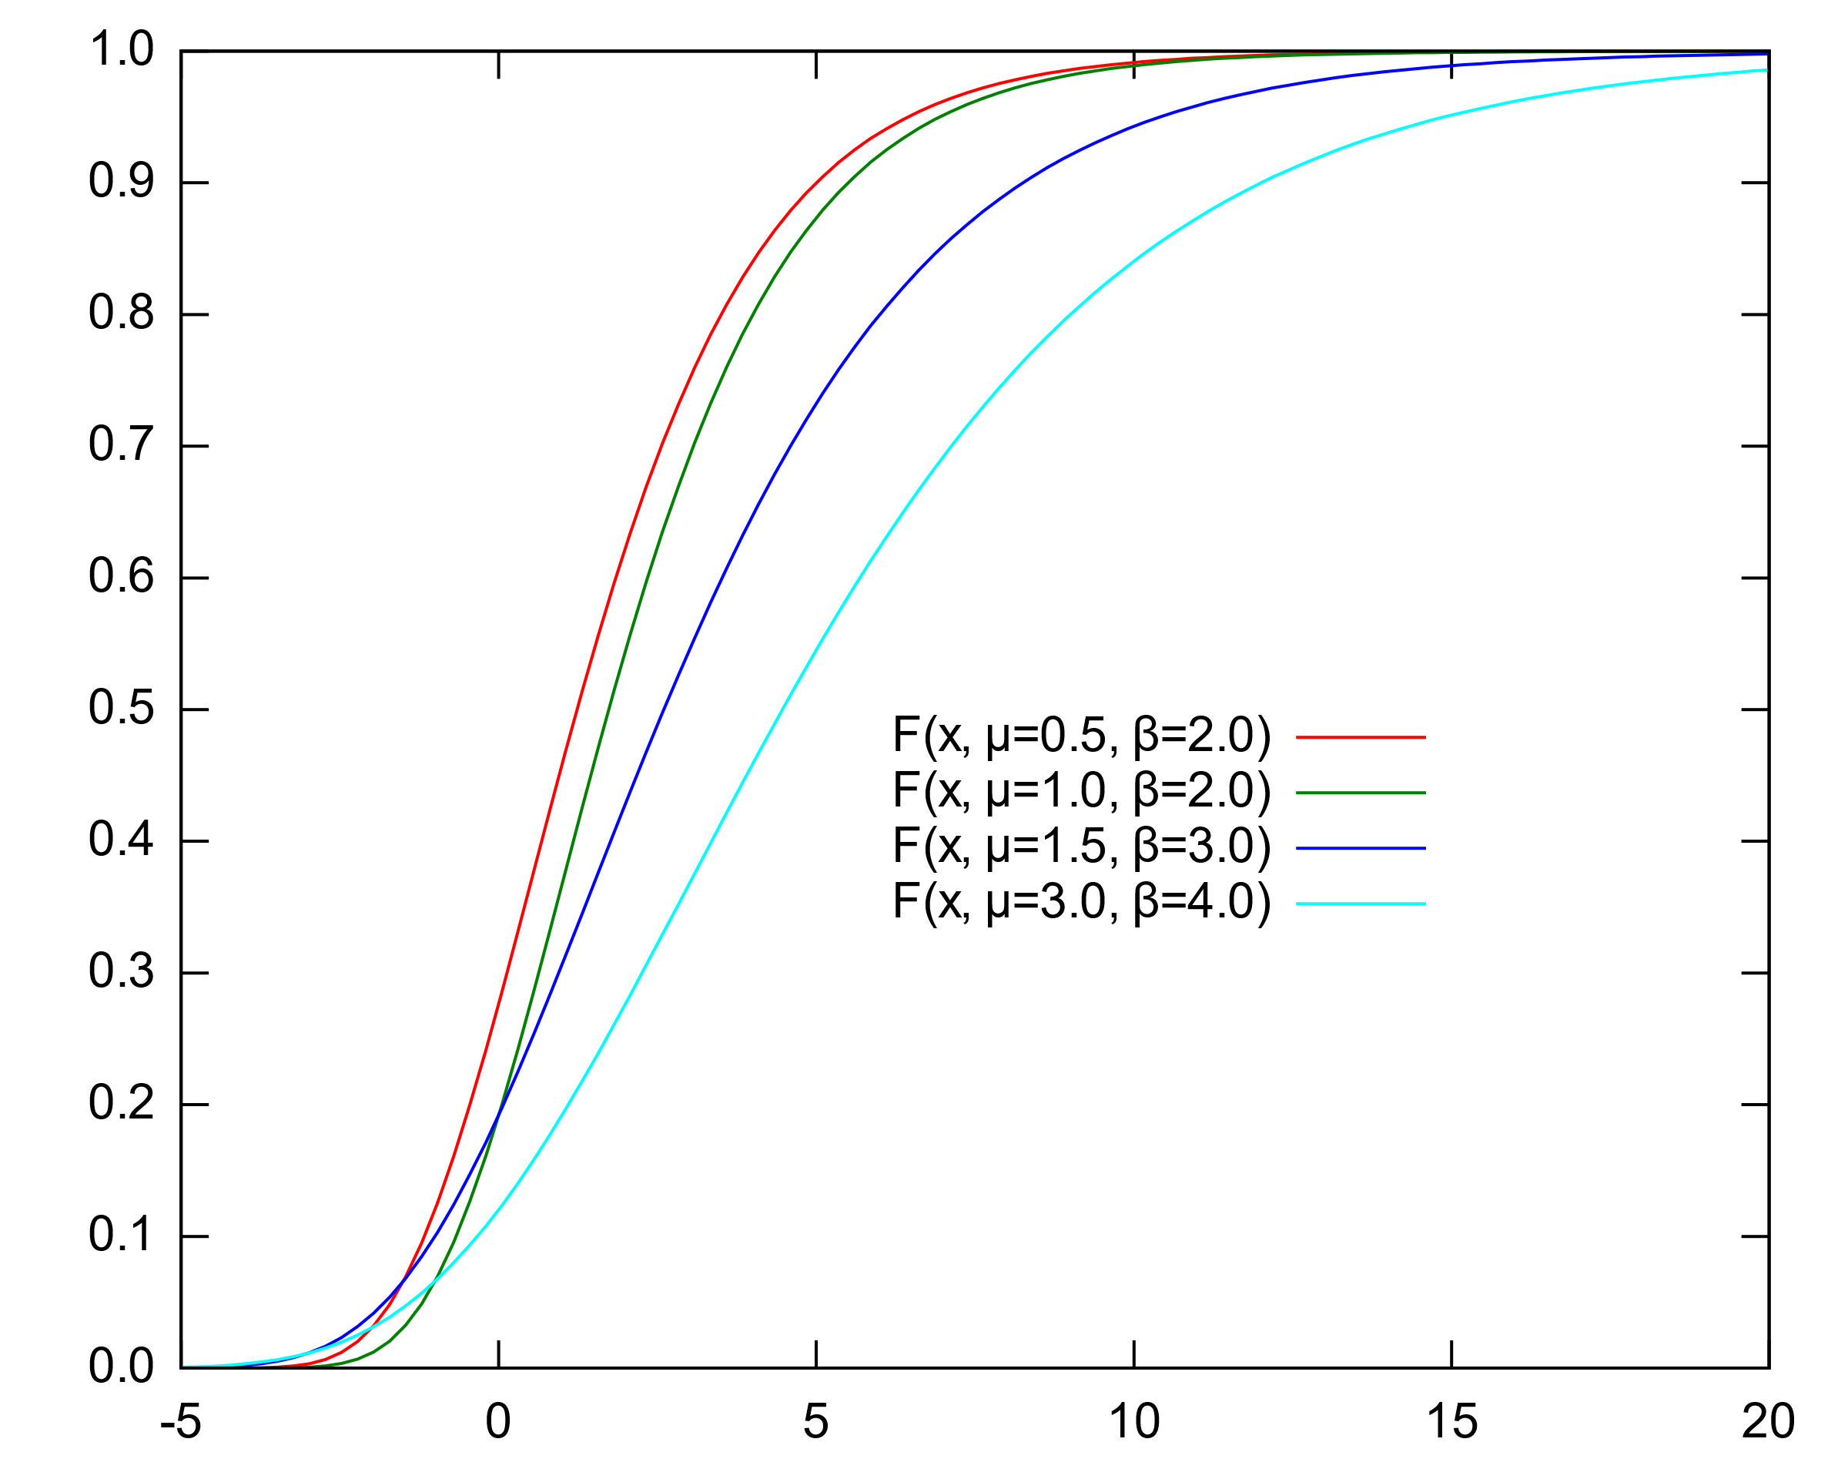

Preliminaries
Extreme Value Theorem (Fisher-Tippett Theorem)
Maximum of i.i.d. samples from exponentially tailed distributions will asymptotically converge to the Gumbel distribution $𝒢(μ,β)$, which has PDF $p\left(x\right)=e^{−(z+e^{−z})}$ where $z=\frac{(x−μ)}{β}$ with location parameter $μ$ and scale parameter $β$.
PDF:
CDF:
Notes:
而Extreme Value Theorem就像是Central limit theorem，只是取平均改成取最大值。那麼取所有最大值出來呈現的分布會是一個Gumbel distribution。底下兩張圖是Gumbel的PDF和CDF。
The Extreme Value Theorem is similar to the Central Limit Theorem, except instead of taking the average, it takes the maximum value. The distribution that results from taking all the maximum values is called the Gumbel distribution. The two graphs below show the PDF and CDF of the Gumbel distribution.

Slide 16
Preliminaries
Extreme Value Theorem (Fisher-Tippett Theorem)
Maximum of i.i.d. samples from exponentially tailed distributions will asymptotically converge to the Gumbel distribution $𝒢(μ,β)$, which has PDF $p\left(x\right)=e^{−(z+e^{−z})}$ where $z=\frac{(x−μ)}{β}$ with location parameter $μ$ and scale parameter $β$.
Objective of RL → Maximum of total expected return.
May have some association.
Notes:
The objective of RL is to take the maximum of total expected return. They may have some association with each other.

Slide 17
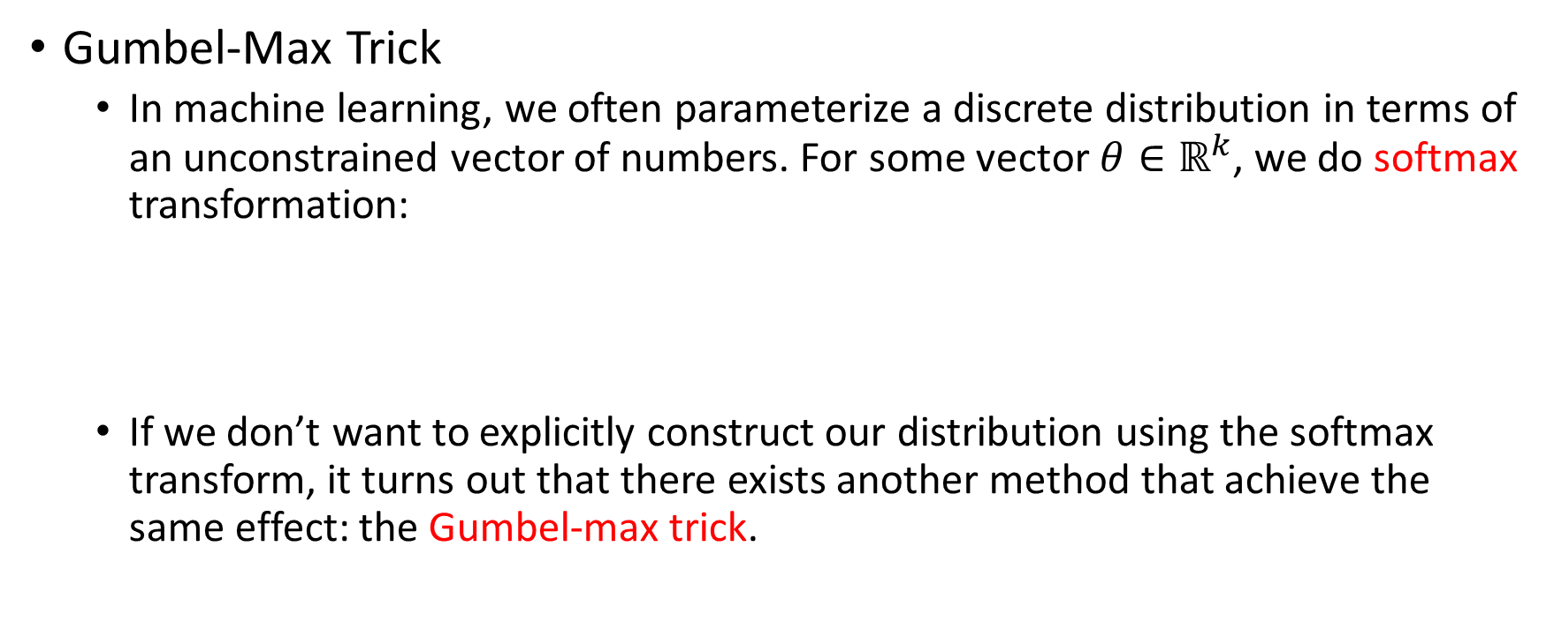
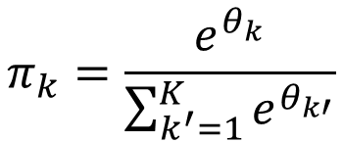
Preliminaries
Gumbel-Max Trick
In machine learning, we often parameterize a discrete distribution in terms of an unconstrained vector of numbers. For some vector $θ∈ℝ^{k}$, we do softmax transformation:
If we don’t want to explicitly construct our distribution using the softmax transform, it turns out that there exists another method that achieve the same effect: the Gumbel-max trick.
$$π_{k}=\frac{e^{θ_{k}}}{\sum_{k^{′}=1}^{K}{e^{θ_{k′}}}}$$
Notes:
Then let me introduce the Gumbel-Max Trick. In machine learning, we often parameterize a discrete distribution in terms of an unconstrained vector of numbers. For some vector $θ∈ℝ^{k}$, we do softmax transformation, like this equation. In the denominator, we take the sum of exponential theta, while in the numerator, we take the exponential of theta individually. And if we don’t want to explicitly construct our distribution using the softmax transform, it turns out that there exists another method for achieving the same effect. That is the Gumbel-max trick.

Slide 18


Preliminaries
Gumbel-Max Trick
For a set of unnormalized probabilities $θ_{k}$, we can draw a sample from the corresponding categorical distribution as follows: for each $θ_{k}$we add a sample $G^{(k)}$ from the standard Gumbel distribution, and then select the index with the maximum sum. That is:
$$I=\underset{k}{argmax}\left\{θ_{k}+G^{\left(k\right)}\right\} \sim Cat(π)$$
Same effect as applying softmax transformation & draw
Many RL Algorithms include sample from a softmax policy.
May have some association.
Notes:
For a set of unnormalized probabilities $θ_{k}$, we can draw a sample from the corresponding categorical distribution as follows: for each $θ_{k}$we add a sample $G^{(k)}$ from the standard Gumbel distribution, and then select the index with the maximum sum. The formulation is like is:
Taking theta k plus a sampled G(k), and take the maximum index, has same effect as applying softmax transformation and draw an index.
Many RL Algorithms include sample from a softmax policy. So they may have some association with each other, too.

Slide 19
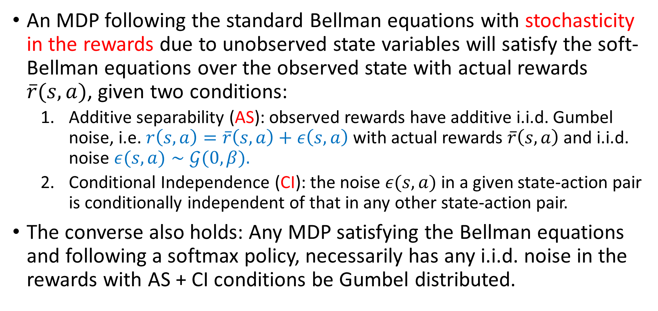
Preliminaries - McFadden-Rust Model
An MDP following the standard Bellman equations with stochasticity in the rewards due to unobserved state variables will satisfy the soft-Bellman equations over the observed state with actual rewards $\overline{r}(s,a)$, given two conditions:
Additive separability (AS): observed rewards have additive i.i.d. Gumbel noise, i.e. $r\left(s,a\right)=\overline{r}\left(s,a\right)+ε\left(s,a\right)$ with actual rewards $\overline{r}\left(s,a\right)$and i.i.d. noise $ε(s, a)∼𝒢(0, β).$
Conditional Independence (CI): the noise $ε(s,a)$ in a given state-action pair is conditionally independent of that in any other state-action pair.
The converse also holds: Any MDP satisfying the Bellman equations and following a softmax policy, necessarily has any i.i.d. noise in the rewards with AS + CI conditions be Gumbel distributed.
Notes:
MDP的McFadden-Rust模型，該模型主要是說對於一個遵循標準貝爾曼方程的MDP，當滿足如下兩個條件時，會遵循soft MDP。
…
根據這些理論，其實我們可以將soft-MDP視為reward function包含Gumbel noise的MDP。
In fact, these properties lead into the McFadden-Rust model of MDPs. The main idea of this model is that for an MDP that follows the standard Bellman equation, when the following two conditions are met, it will follow the regularized MDP.
First is Additive separability (AS): observed rewards have additive i.i.d. Gumbel noise, i.e. $r\left(s,a\right)=\overline{r}\left(s,a\right)+ε(s,a)$ with actual rewards $\overline{r}\left(s,a\right)$and i.i.d. noise $ε(s, a)∼𝒢(0, β).$
Second is Conditional Independence (CI): the noise $ε(s,a)$ in a given state-action pair is conditionally independent of that in any other state-action pair.
And the converse also holds: That is any MDP satisfying the Bellman equations and following a softmax policy, necessarily has any i.i.d. noise in the rewards with AS + CI conditions be Gumbel distributed.
Based on these theories, we can actually view the regularized MDP as an MDP with a reward function that includes Gumbel noise.

Slide 20
Extreme Q-Learning
XQL

Slide 21

Gumbel Regression
Consider estimating a parameter $h$ for a random variable $X$ using samples $x_{i}$ from a dataset $𝒟$, which have Gumbel distributed noise, i.e. $x_{i}=h+ε_{i}$ where $ε_{i}∼−𝒢(0, β)$. Then, the average log-likelihood of the dataset $D$ as a function of $h$ is given as:
Recall: Gumbel’s PDF $p\left(x\right)=e^{−(z+e^{−z})}$ where $z=\frac{(x−μ)}{β}$
Notes:
This paper presents the Gumbel Regression. Consider estimating a parameter $h$ for a random variable $X$ using samples $x_{i}$ from a dataset $𝒟$, which have Gumbel distributed noise, i.e. $x_{i}=h+ε_{i}$ where $ε_{i}∼−𝒢(0, β)$. Then, the average log-likelihood of the dataset $D$ as a function of $h$ is given as this equation.

Slide 22
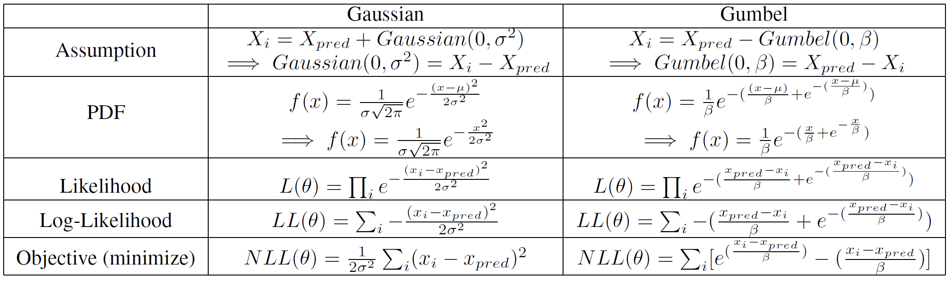
Gumbel Regression
Notes:
I draw a table that helps you understand the concept of Gumbel regression. In Gaussian models, we assume that Xi we draw equals to X we predict plus a Gaussian error with 0, sigma square. Then we can write the Gaussian error as Xi minus X predict. We want to fit the error, so we can replace x in PDF with Xi minus X predict, and take the product of all X. That forms the Likelihood function. Then take the Log will remove exponential and change the product to sum. Maximize Log-Likelihood is the same as minimize Negative Log-Likelihood. So finally, we get exactly the MSE loss.
And the Gumbel regression here, we assume that Xi we draw equals to X we predict minus a Gumbel error with 0, beta, then following the previous procedure. We can get the objective there.

Slide 23


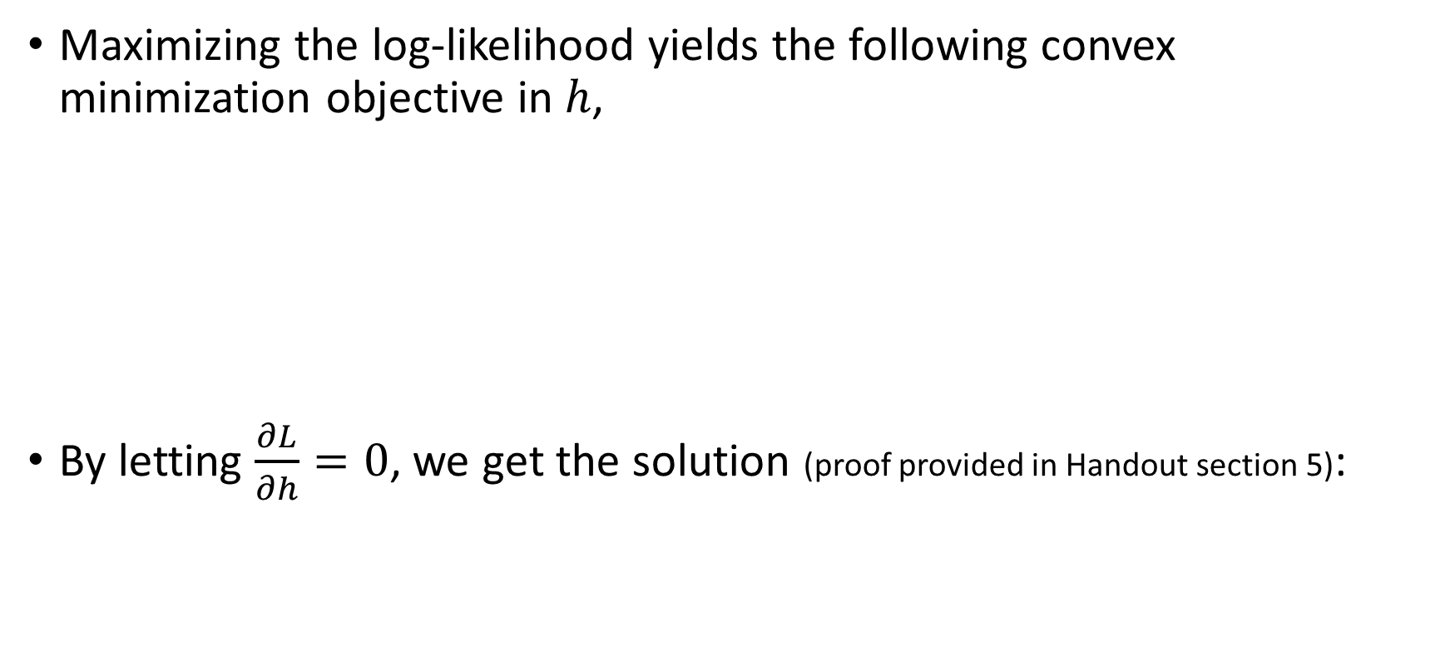
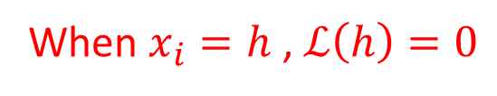
Gumbel Regression
Maximizing the log-likelihood yields the following convex minimization objective in $h$,
By letting $\frac{∂L}{∂h}=0$, we get the solution (proof provided in Handout section 5):
When $x_{i}=h$ , $ℒ\left(h\right)=0$
This is the Log-Sum-Exp term !!!
Notes:
Rewrite the objective as sample Xi from D, will form this equation. The -1 here is that when Xi equals to h, the loss should be 0. And by taking the gradient, we can get the solution. When h equals to beta, log, Expectation over Xi divided by beta, the loss has minimal. Note that this is exactly the Log-Sum-Exp term, same as optimal soft V values’ term that I mentioned before.

Slide 24


Gumbel Regression with MAXENT RL
Construct the $ExtremeV$ loss function:
Directly models the Log-Sum-Exp term over Q.
Update soft V without considering the policy.
We want to predict V
Prediction error of V
Online setting: old policy (sampled from the replay buffer)
Offline setting: $π_{D}$ (sampled from a fixed offline buffer)
Notes:
We can then combined Gumbel regression with Maxent RL. Construct the $ExtremeV$ loss function as following equation.
V is what we want to predict, Q equals to r plus max V, which is the TD target. So Q-V is the prediction error of V.
And mu there in Online RL setting, is the old policy, which can be viewed as sample (s,a) pair from the replay buffer. While in Offline RL setting, mu is $π_{D}$ , that is sample (s,a) pair from a fixed offline buffer.
This equation directly models the Log-Sum-Exp term over Q, and can update soft V without considering the policy.

Slide 25

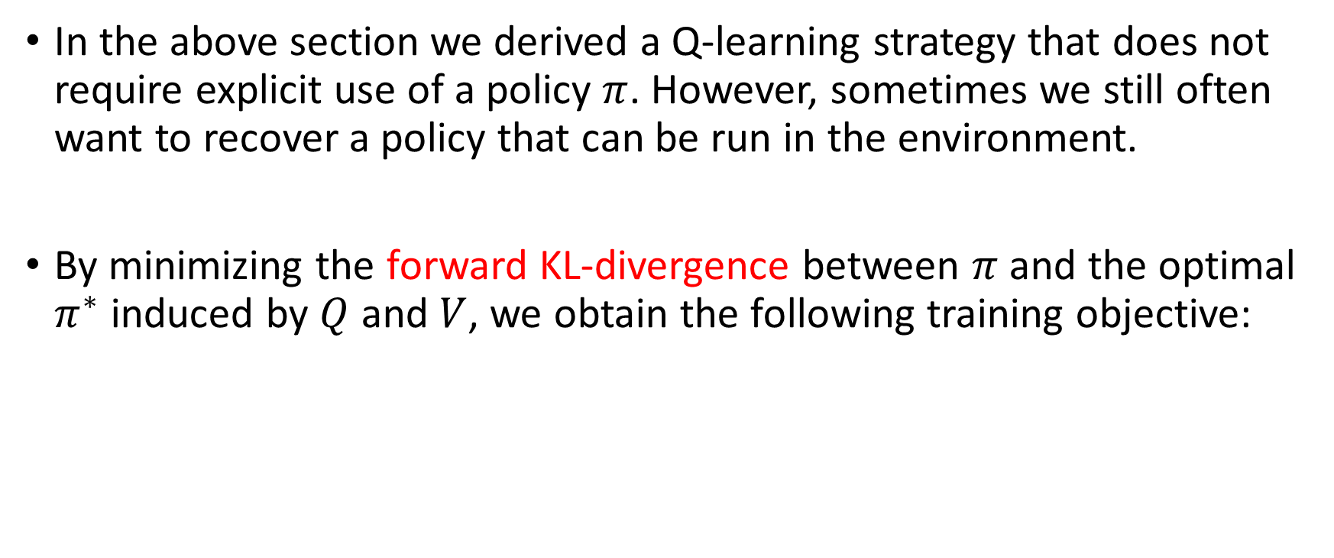

Learning Policies Offline
In the above section we derived a Q-learning strategy that does not require explicit use of a policy $π$. However, sometimes we still often want to recover a policy that can be run in the environment.
By minimizing the forward KL-divergence between $π$ and the optimal $π^{∗}$ induced by $Q$ and $V$, we obtain the following training objective:
$$D_{KL}(π^{∗}||π)$$
$ρ_{μ}$ is a offline dataset $D$.

Slide 26



Learning Policies Online
Alternatively, if we want to sample from the policy instead of the reference distribution $μ$, we can minimize the Reverse KL-divergence which gives us the SAC-like actor update:
$$D_{KL}(π||π^{∗})$$

Slide 27
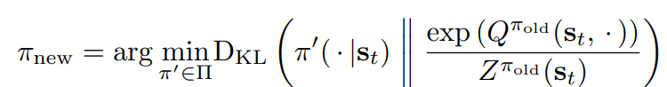

Learning Policies Online
Choose $μ$ to be uniform SAC
SAC policy improvement step:
SAC policy objective (minimize):

Slide 28
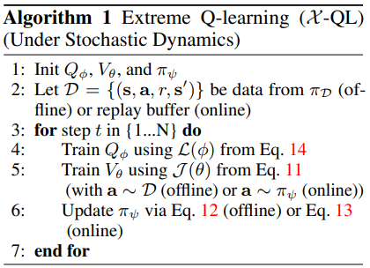
Practical Algorithm
Notes:
這是他們提出的XQL演算法。可以看到他非常簡潔，只有7行。注意到在第二行這邊，D can be data from pi_D (offline) or replay buffer (online)。
This is the XQL algorithm proposed by them. As you can see, it is very concise, consisting of only 7 lines of code. Note that in the second line, D can be data from pi_D (offline) or a replay buffer (online).

Slide 29
Practical Algorithm
(11)
(12)
(13)
(14)

Slide 30
Practical Algorithm
MSE Loss
Notes:
They separate the optimization of V and Q, and first train Q value by the MSE loss.

Slide 31
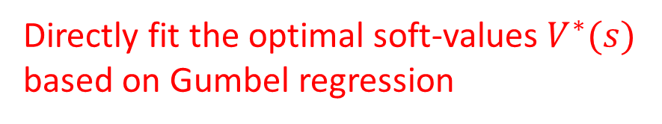
Practical Algorithm
Directly fit the optimal soft-values $V^{∗}(s)$
based on Gumbel regression
Notes:
Then train V by directly fit the optimal soft-values $V^{∗}(s)$ based on Gumbel regression that I mentioned previously.

Slide 32
Practical Algorithm
Offline setting
Notes:
In the above section we derived a Q-learning strategy that does not require explicit use of a policy. However, sometimes we still often want to recover a policy that can be run in the environment. In offline setting, we can recover pi by this equation.

Slide 33
Practical Algorithm
Online setting
Notes:
And in Online setting, we can recover pi by this equation.

Slide 34
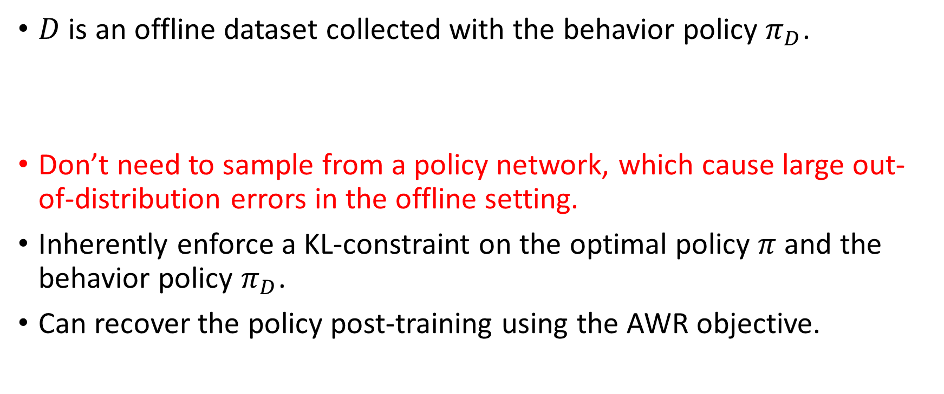
Supplementation of Offline RL
$D$ is an offline dataset collected with the behavior policy $π_{D}$.
Don’t need to sample from a policy network, which cause large out-of-distribution errors in the offline setting.
Inherently enforce a KL-constraint on the optimal policy $π$ and the behavior policy $π_{D}$.
Can recover the policy post-training using the AWR objective.

Slide 35
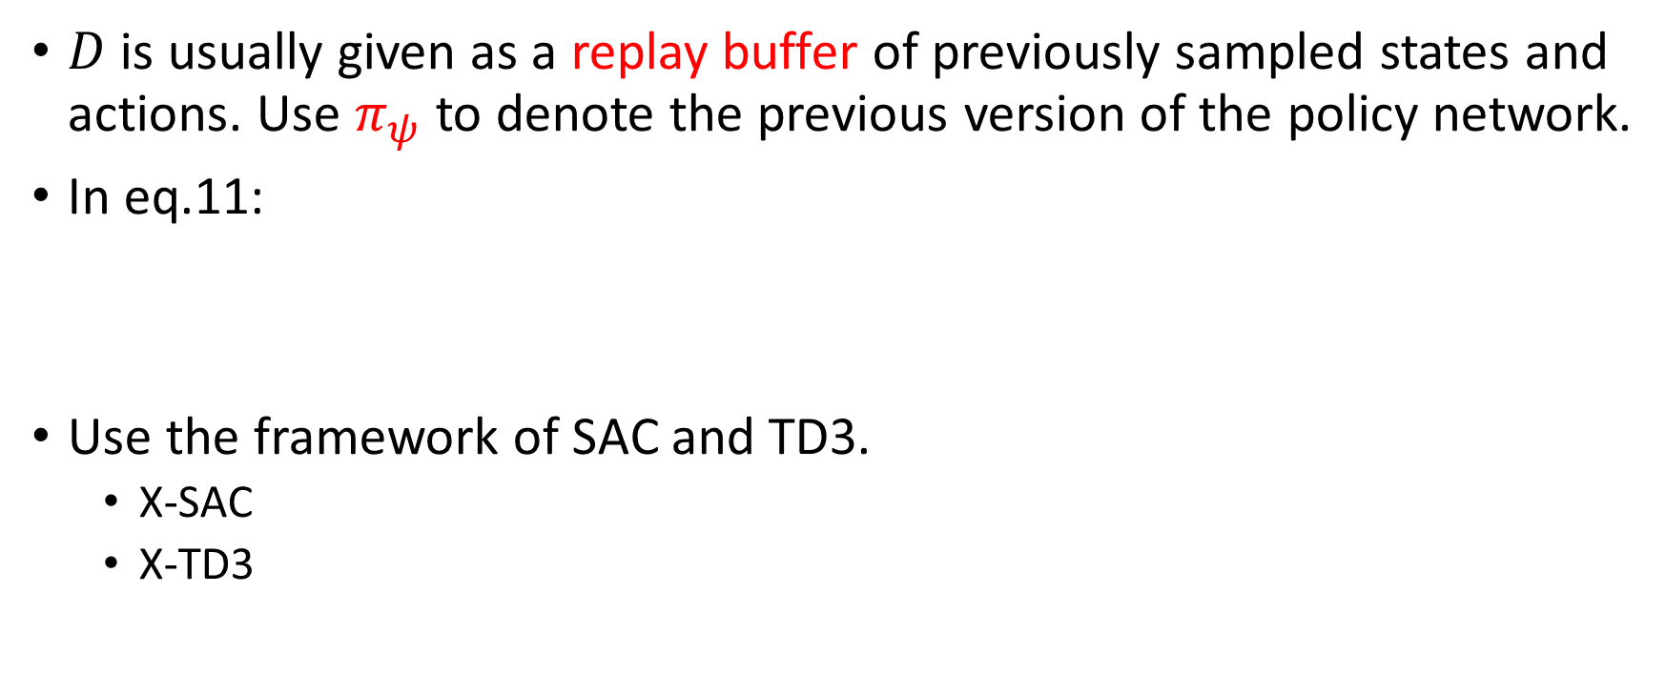


Supplementation of Online RL
$D$ is usually given as a replay buffer of previously sampled states and actions. Use $π_{ψ}$ to denote the previous version of the policy network.
In eq.11:
Use the framework of SAC and TD3.
X-SAC
X-TD3
$$s\sim D, a\sim π_{ψ_{k}}\left(a | s\right)$$
$$s\sim D, a\sim π_{ψ_{k}}\left(a | s\right)$$

Slide 36
Experiments

Slide 37
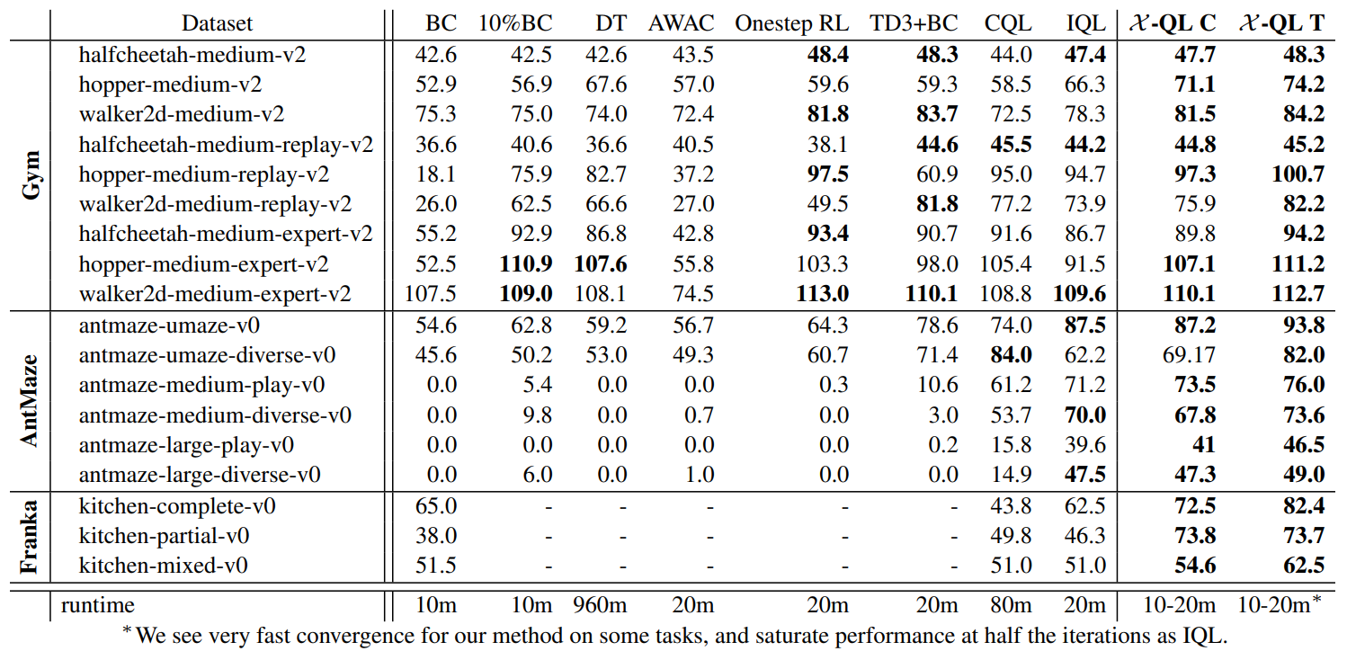
Offline
Consistent hyperparameter
Tuning
Notes:
實驗包含兩大部分: 分為Offline的task和Online的task。首先是offline的部分。縱軸是套用在各種不同的dataset上，橫軸是和其他offline RL的方法做比較。而XQL的C表示用一樣的hyperparameter套用在不同的task上；而T表示有針對不同的task去做hyperparameter tuning。我們可以發現到，就算不做hyperparameter tuning，其效果還是大部分都很好；而做了tuning，不僅效果更好，也能在更短的時間達到收斂。

Slide 38
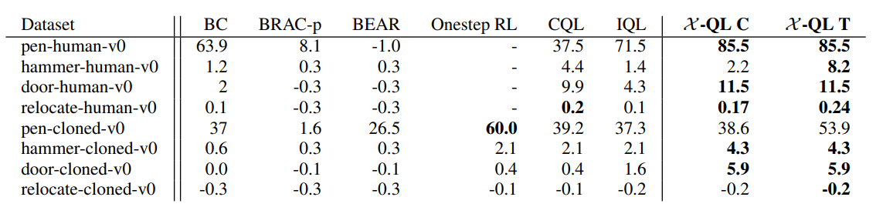
Offline - Androit benchmark in D4RL
Notes:
另外這是在D4RL的Androit benchmark，也可以得到很好的效果。

Slide 39
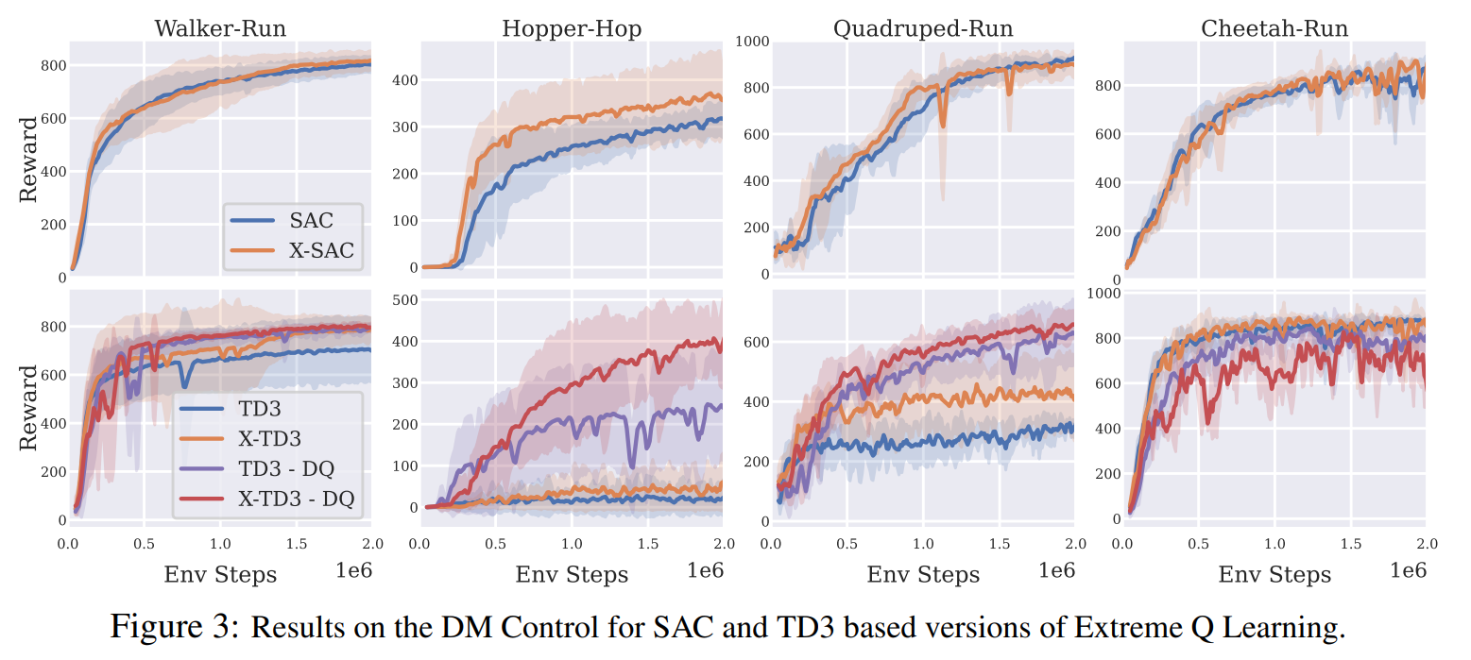
Online - DM Control
Notes:
In online tasks, they combined this new update method with TD3 and SAC, resulting in “X-SAC” and "X-TD3," both of which achieved better performance than their original counterparts. With regard to the –DQ here, they believe the Gumbel loss function helps with overestimation, without double Q-learning

Slide 40
Conclusion

Slide 41
Conclusion
This paper proposed a new framework for MaxEnt RL that directly estimates the optimal Bellman backup without relying on explicit access to a policy.
Empirically, They show that their framework can be used to develop simple, performant RL algorithms.
Their resulting algorithms surpass or consistently match state-of-the-art (SOTA) methods while being practically simpler.

